Slide 1
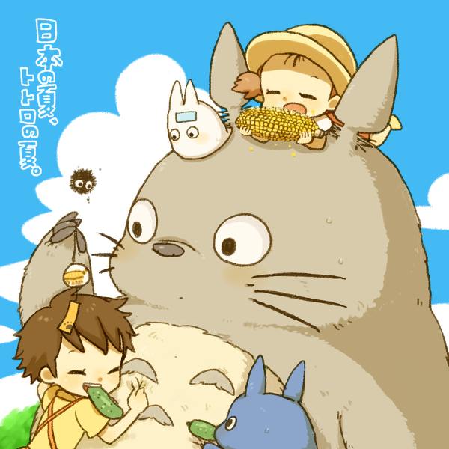

龙猫の夏日
卡通插画通用模板
龙猫

Slide 2

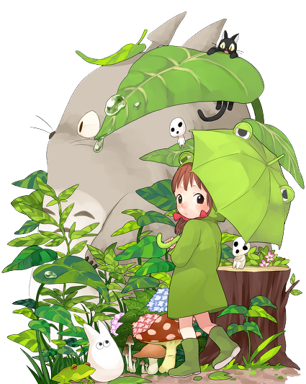

目录
01
01
这里填写标题
One day, a monkey rides his bike near the river. This time he sees a lion under a tree. The lion runs at him.
02
02
这里填写标题
One day, a monkey rides his bike near the river. This time he sees a lion under a tree. The lion runs at him.
03
03
这里填写标题
One day, a monkey rides his bike near the river. This time he sees a lion under a tree. The lion runs at him.

Slide 3
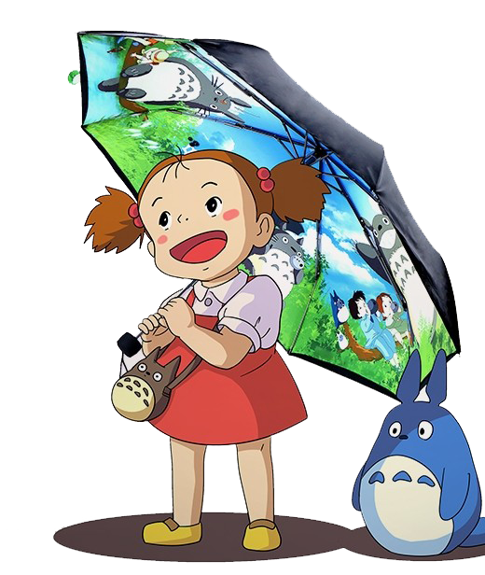
01
01
这里填写标题
One day, a monkey rides his bike near the river. This time he sees a lion under a tree. The lion runs at him. He is afraid and falls into the river. He can’t swim. He shouts. The rabbit hears him. He jumps into the river. The rabbit swims to the monkey, but he can’t help him. Luckily, an elephant comes along. He is very strong. He helps the rabbit and monkey. Three friends are very happy. They go to the elephant’s home. Then, three of them become good friends. One day, a monkey rides his bike near the river. This time he sees a lion under a tree.

Slide 4

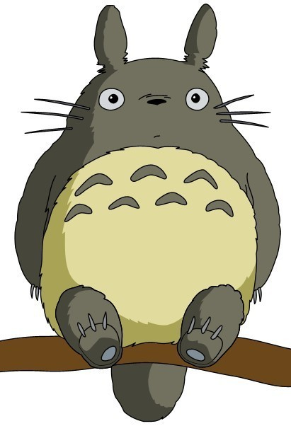
这里填写标题
这里填写标题
One day, a monkey rides his bike near the river. This time he sees a lion under a tree. The lion runs at him. He is afraid and falls into the river. He can’t swim. He shouts. The rabbit hears him. He jumps into the river. The rabbit swims to the monkey, but he can’t help him. Luckily, an elephant comes along. He is very strong. He helps the rabbit and monkey. Three friends are very happy. They go to the elephant’s home.

Slide 5
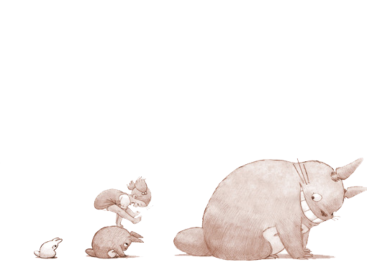
这里填写标题
这里填写标题
这里填写标题
这里填写标题
One day, a monkey rides his bike near the river. This time he sees a lion under a tree. The lion runs at him. He is afraid and falls into the river. He can’t swim. He shouts.
One day, a monkey rides his bike near the river. This time he sees a lion under a tree. The lion runs at him. He is afraid and falls into the river. He can’t swim. He shouts.
One day, a monkey rides his bike near the river. This time he sees a lion under a tree. The lion runs at him. He is afraid and falls into the river. He can’t swim. He shouts.

Slide 6
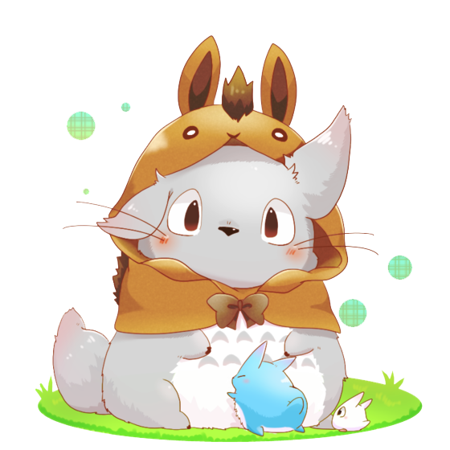
这里填写标题
这里填写标题
这里填写标题
One day, a monkey rides his bike near the river. This time he sees a lion under a tree. The lion runs at him. He is afraid and falls into the river. He can’t swim. He shouts. The rabbit hears him. He jumps into the river. The rabbit swims to the monkey,
One day, a monkey rides his bike near the river. This time he sees a lion under a tree. The lion runs at him. He is afraid and falls into the river. He can’t swim. He shouts. The rabbit hears him. He jumps into the river. The rabbit swims to the monkey, but he can’t help him. Luckily, an elephant comes along

Slide 7
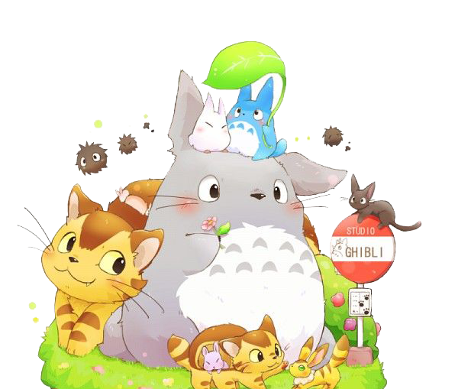
这里填写标题
这里填写标题
One day, a monkey rides his bike near the river. This time he sees a lion under a tree. The lion runs at him. He is afraid and falls into the river. He can’t swim. He shouts. The rabbit hears him. He jumps into the river. The rabbit swims to the monkey, but he can’t help him. Luckily, an elephant comes along
这里填写标题
One day, a monkey rides his bike near the river. This time he sees a lion under a tree. The lion runs at him. He is afraid and falls into the river. He can’t swim. He shouts. The rabbit hears him. He jumps into the river. The rabbit swims to the monkey, but he can’t help him. Luckily, an elephant comes along

Slide 8
02
02
这里填写标题
One day, a monkey rides his bike near the river. This time he sees a lion under a tree. The lion runs at him. He is afraid and falls into the river. He can’t swim. He shouts. The rabbit hears him. He jumps into the river. The rabbit swims to the monkey, but he can’t help him. Luckily, an elephant comes along. He is very strong. He helps the rabbit and monkey. Three friends are very happy. They go to the elephant’s home. Then, three of them become good friends. One day, a monkey rides his bike near the river. This time he sees a lion under a tree.

Slide 9
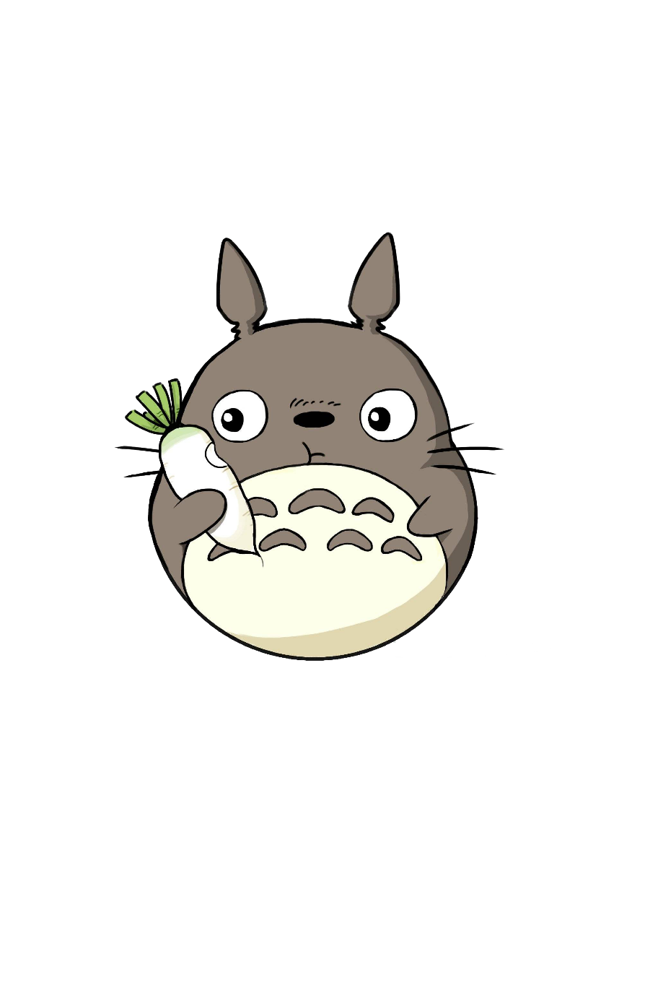

这里填写标题
这里填写标题
One day, a monkey rides his bike near the river. This time he sees a lion under a tree. The lion runs at him. He is afraid and falls into the river. He can’t swim. He shouts. The rabbit hears him. He jumps into the river. The rabbit swims to the monkey, but he can’t help him. Luckily, an elephant comes along. He is very strong. He helps the rabbit and monkey. Three friends are very happy. They go to the elephant’s home. Then, three of them become good friends. One day, a monkey rides his bike near the river. This time he sees a lion under a tree.

Slide 10
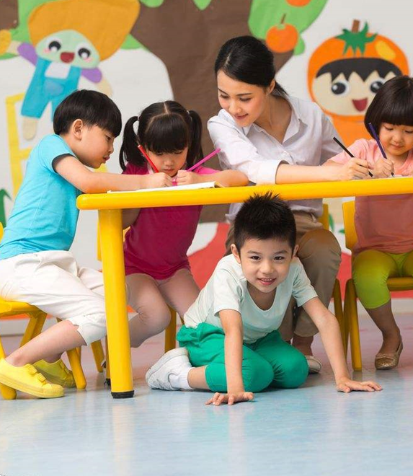
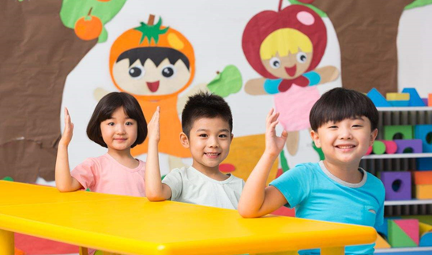
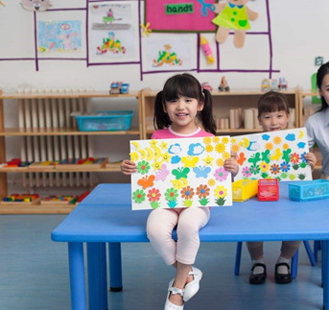
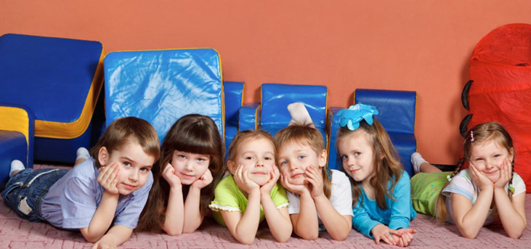
这里填写标题
右键图片——设置图片格式——进行图片替换
One day, a monkey rides his bike near the river. This time he sees a lion under a tree. The lion runs at him. He is afraid and falls into the river. He can’t swim. He shouts. The rabbit hears him. He jumps into the river. The rabbit swims to the monkey,

Slide 11


这里填写标题
这里填写标题
One day, a monkey rides his bike near the river. This time he sees a lion under a tree. The lion runs at him. He is afraid and falls into the river. He can’t swim. He shouts.
这里填写标题
One day, a monkey rides his bike near the river. This time he sees a lion under a tree. The lion runs at him. He is afraid and falls into the river. He can’t swim. He shouts.
这里填写标题
One day, a monkey rides his bike near the river. This time he sees a lion under a tree. The lion runs at him. He is afraid and falls into the river. He can’t swim. He shouts.

Slide 12
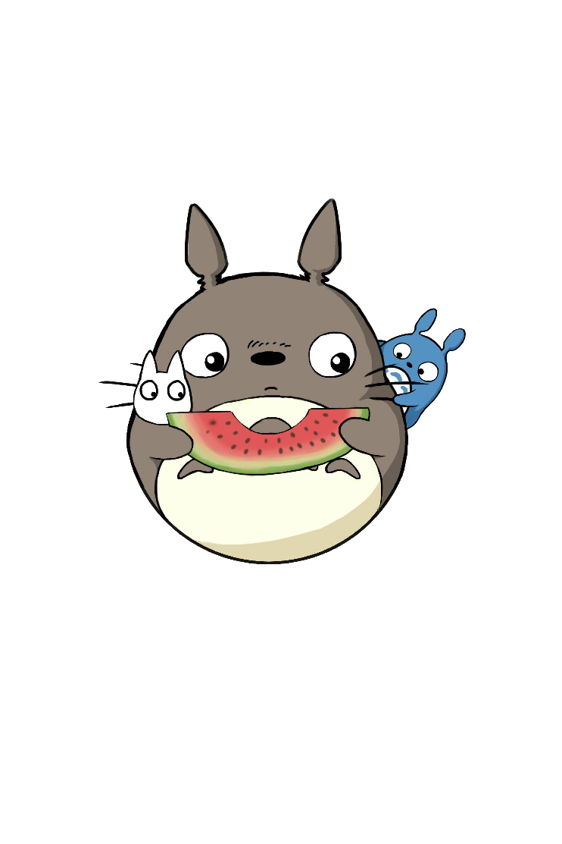
这里填写标题
这里填写标题
这里填写标题
One day, a monkey rides his bike near the river. This time he sees a lion under a tree. The lion runs at him. He is afraid and falls into the river. He can’t swim. He shouts. The rabbit hears him. He jumps into the river. The rabbit swims to the monkey, but he can’t help him. Luckily, an elephant comes along
One day, a monkey rides his bike near the river. This time he sees a lion under a tree. The lion runs at him. He is afraid and falls into the river.
这里填写标题
One day, a monkey rides his bike near the river. This time he sees a lion under a tree. The lion runs at him. He is afraid and falls into the river.

Slide 13
03
03
这里填写标题
One day, a monkey rides his bike near the river. This time he sees a lion under a tree. The lion runs at him. He is afraid and falls into the river. He can’t swim. He shouts. The rabbit hears him. He jumps into the river. The rabbit swims to the monkey, but he can’t help him. Luckily, an elephant comes along. He is very strong. He helps the rabbit and monkey. Three friends are very happy. They go to the elephant’s home. Then, three of them become good friends. One day, a monkey rides his bike near the river. This time he sees a lion under a tree.

Slide 14


这里填写标题
这里填写标题
这里填写标题
One day, a monkey rides his bike near the river. This time he sees a lion under a tree. The lion runs at him. He is afraid and falls into the river. He can’t swim. He shouts.
One day, a monkey rides his bike near the river. This time he sees a lion under a tree. The lion runs at him. He is afraid and falls into the river. He can’t swim. He shouts.
这里填写标题
这里填写标题
One day, a monkey rides his bike near the river. This time he sees a lion under a tree. The lion runs at him. He is afraid and falls into the river. He can’t swim. He shouts.
One day, a monkey rides his bike near the river. This time he sees a lion under a tree. The lion runs at him. He is afraid and falls into the river. He can’t swim. He shouts.

Slide 15


这里填写标题
这里填写标题
One day, a monkey rides his bike near the river. This time he sees a lion under a tree. The lion runs at him. He is afraid and falls into the river. He can’t swim. He shouts.
这里填写标题
One day, a monkey rides his bike near the river. This time he sees a lion under a tree. The lion runs at him. He is afraid and falls into the river. He can’t swim. He shouts. The rabbit hears him. He jumps into the river. The rabbit swims to the monkey, but he can’t help him. Luckily, an elephant comes along

Slide 16


这里填写标题
这里填写标题
这里填写标题
One day, a monkey rides his bike near the river. This time he sees a lion under a tree. The lion runs at him. He is afraid and falls into the river. He can’t swim. He shouts. The rabbit hears him. He jumps into the river. The rabbit swims to the monkey, but he can’t help him. Luckily, an elephant comes along
One day, a monkey rides his bike near the river. This time he sees a lion under a tree. The lion runs at him. He is afraid and falls into the river. He can’t swim. He shouts. The rabbit hears him. He jumps into the river. The rabbit swims to the monkey, but he can’t help him. Luckily, an elephant comes along

Slide 17
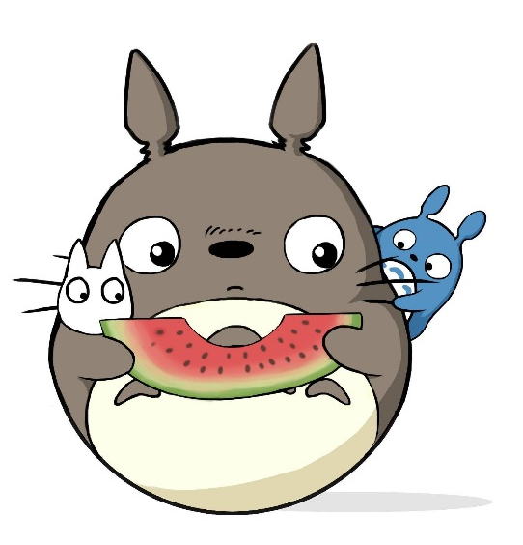
这里填写标题
这里填写标题
这里填写标题
这里填写标题
One day, a monkey rides his bike near the river. This time he sees a lion under a tree. The lion runs at him. He is afraid and falls into the river. He can’t swim. He shouts.
One day, a monkey rides his bike near the river. This time he sees a lion under a tree. The lion runs at him. He is afraid and falls into the river. He can’t swim. He shouts.
One day, a monkey rides his bike near the river. This time he sees a lion under a tree. The lion runs at him. He is afraid and falls into the river. He can’t swim. He shouts.

Slide 18
感谢聆听
祝愿小朋友们健康成长
龙猫

